Slide 1

Building Tesla’s Battery Range Calculator with Vue

Slide 2
Agenda workshop

Slide 3


Component based
Focused on the view layer (all browsers)
Integration with Angular or React
Small and compact (21 Kb)

Slide 4
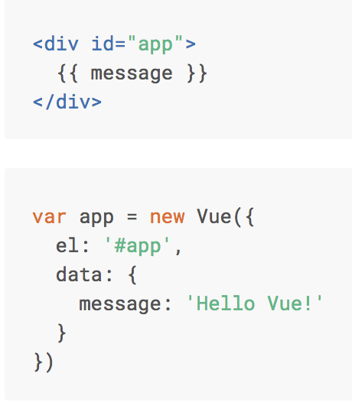

Basics Vue.js

Slide 5
Interpolation
<span> Message: {{ message }} </span>

Slide 6
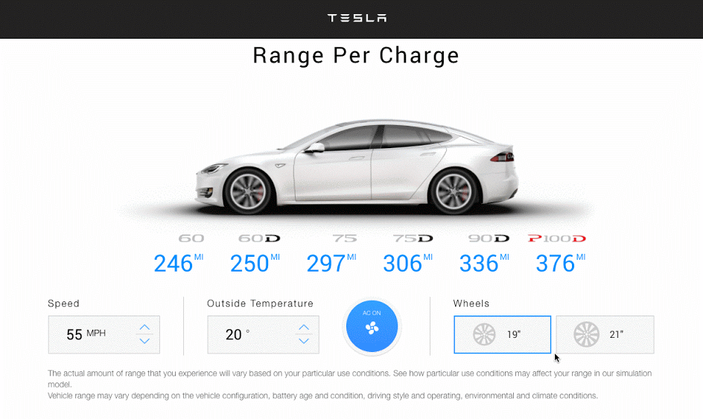

Slide 7
Live version
http://react-tesla-charge-calculator.surge.sh/

Slide 8
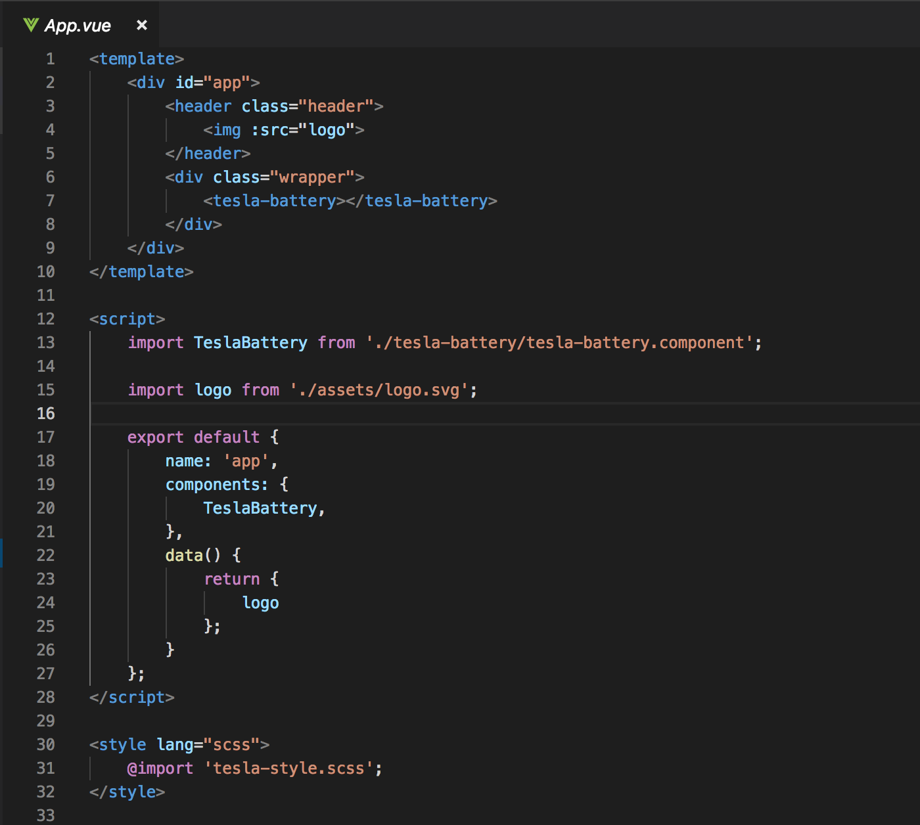
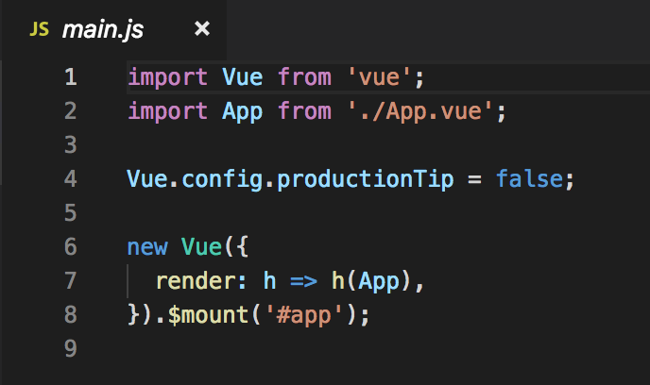
Entry Point => main.js => App.vue

Slide 9
Component based

Slide 10
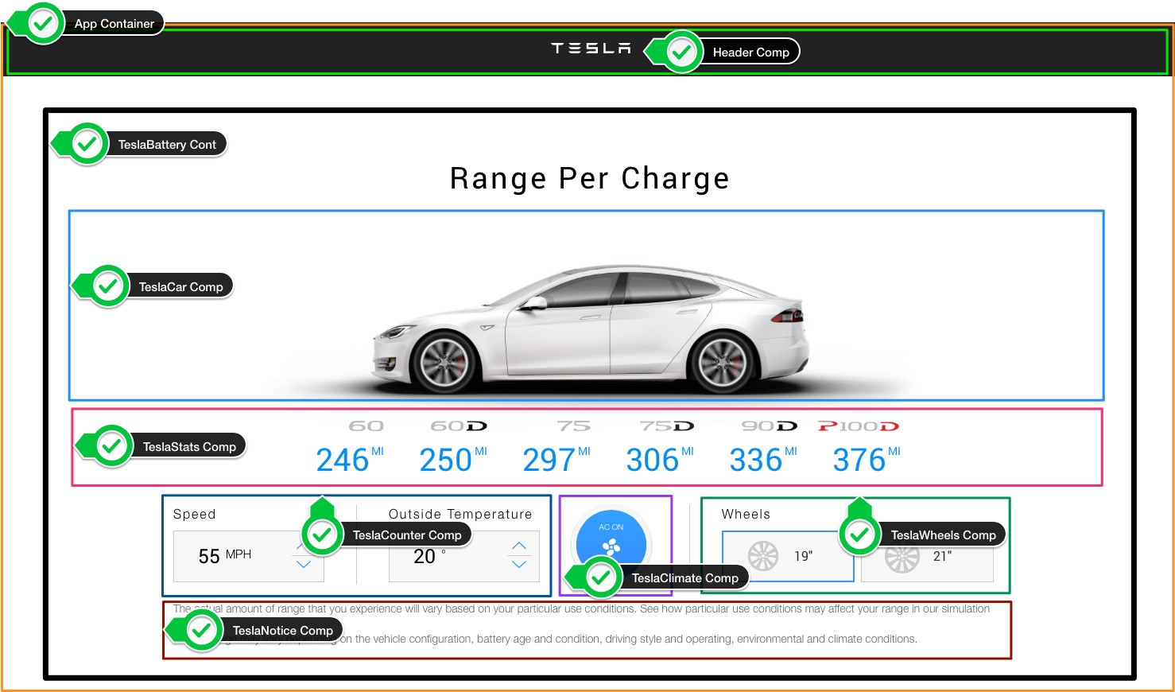

Slide 11
The UI is represented by a component tree
<App> -- Application entry point <TeslaHeader></TeslaHeader> <TeslaBattery> -- Container Component <TeslaCar /> -- Presentational Component <TeslaStats /> -- Presentational Component <TeslaCounter /> -- Presentational Component <TeslaClimate /> -- Presentational Component <TeslaWheels /> -- Presentational Component <TeslaNotice /> -- Presentational Component </TeslaBattery> </App>

Slide 12
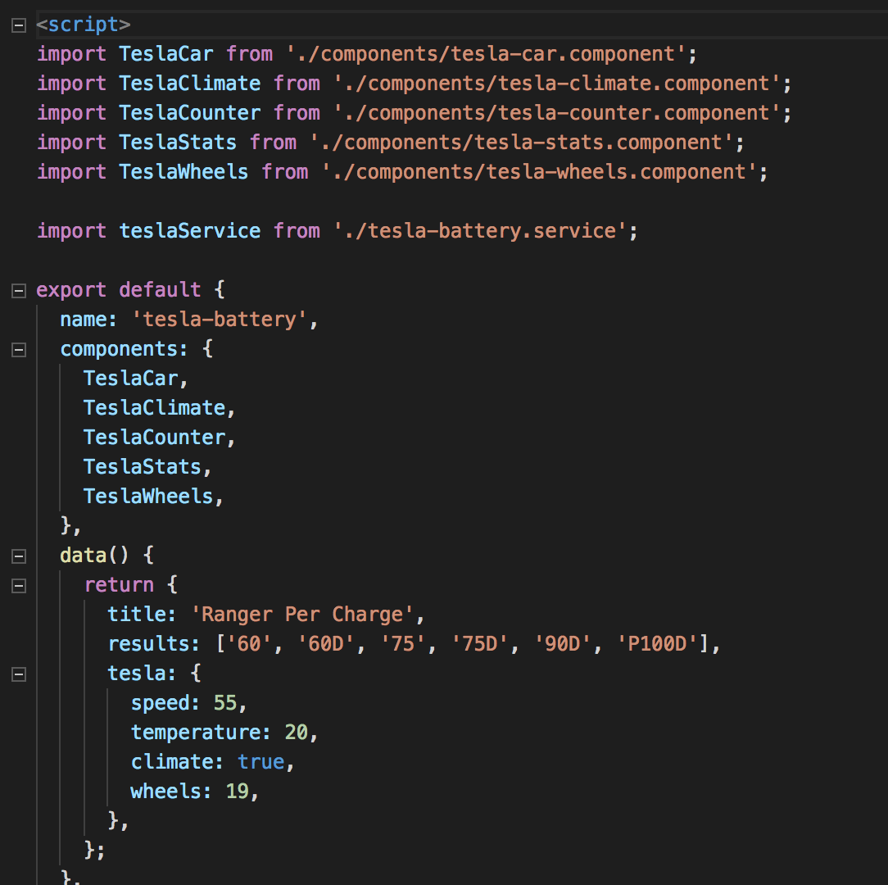
Tesla Battery Component (Container component)

Slide 13
Container Component (stateful component)
- Are concerned with how things work. - In general, except for some wrapping divs, they do not have their own DOM markup and have no style. - Provide data and actions to presentational or other container components. - Are often stateful, as they tend to serve as data sources.

Slide 14
Presentational Component (stateless component)
- Are concerned with how things look. - Usually have some DOM markup and styles of their own. - Receive data and callbacks exclusively via props. - Rarely have their own state (when they do, it’s UI state rather than data).

Slide 15
What are the benefits of using these patterns?
Better separation of concerns
Better reusability
Extract layout components to prevent duplication

Slide 16
Components tree
App.vue
props
TeslaHeader
TeslaBattery
props
props
props
props
props
TeslaCar
TeslaStats
TeslaCounter
TeslaClimate
TeslaWheels

Slide 17
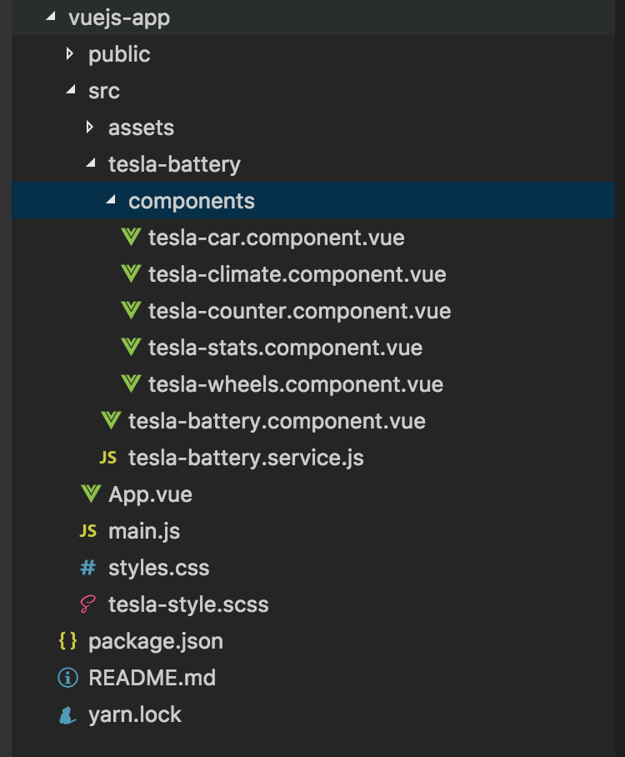

Slide 18
tesla-header.component
Step1 Create a tesla-header.component.vue file
Step 2 Import tesla-header.component in App.vue

Slide 19
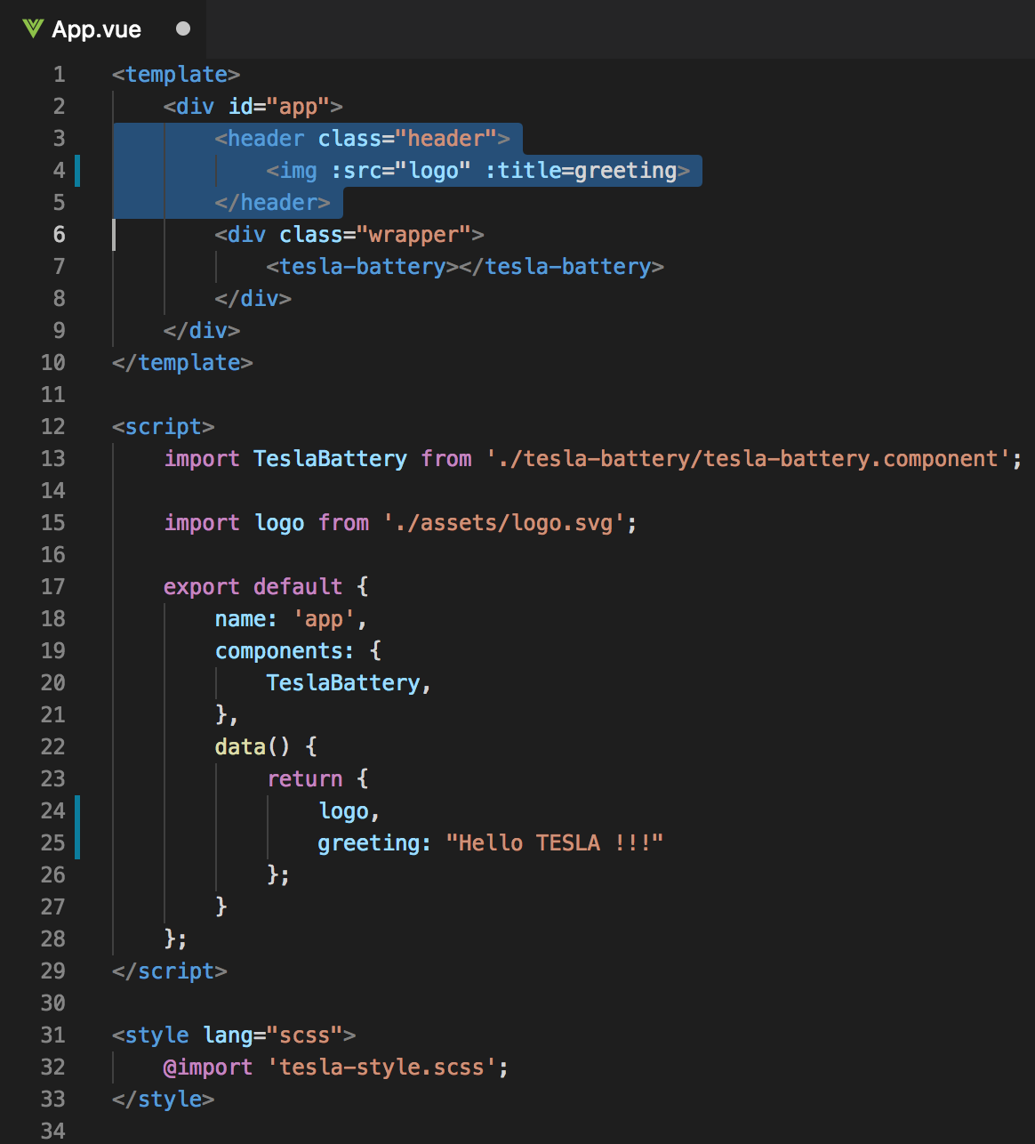
Huidige App.vue

Slide 20
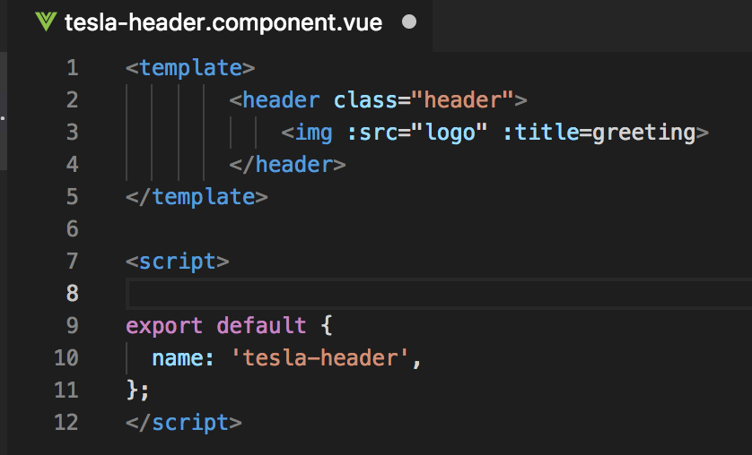
Step1 tesla-header.component.vue

Slide 21
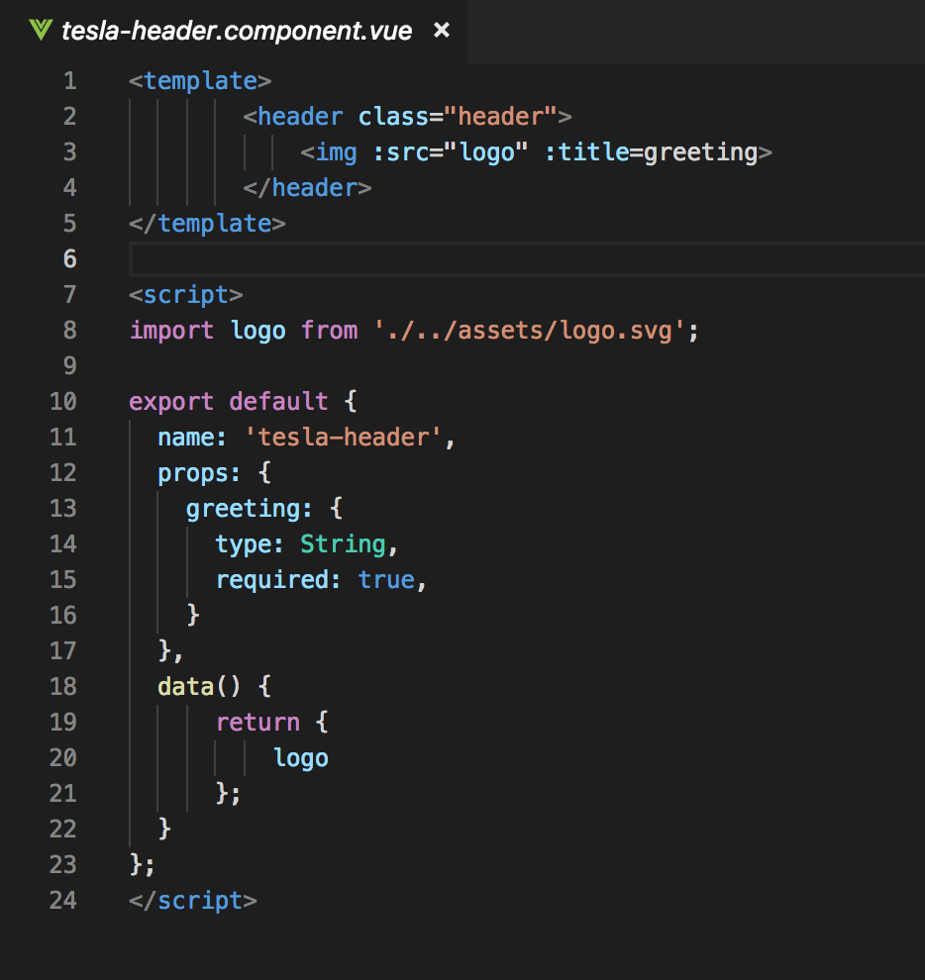
Step1 tesla-header.component.vue
Notes:
Name
Props → logo

Slide 22
Components tree
App.vue
props: “greeting”
TeslaHeader
TeslaBattery
props
props
props
props
props
TeslaCar
TeslaStats
TeslaCounter
TeslaClimate
TeslaWheels

Slide 23
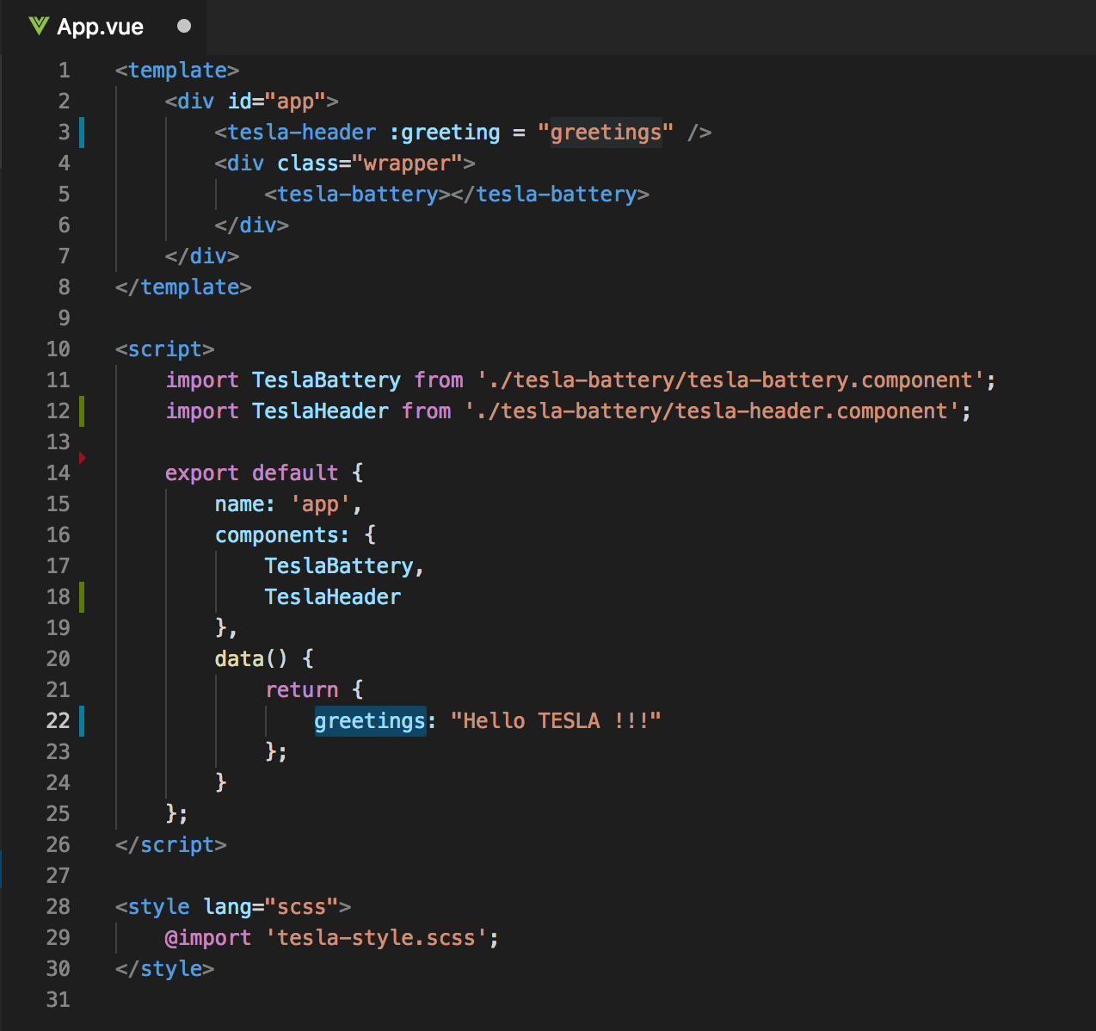
Step 2 Import tesla-header.component in App.vue
Old
New

Slide 24
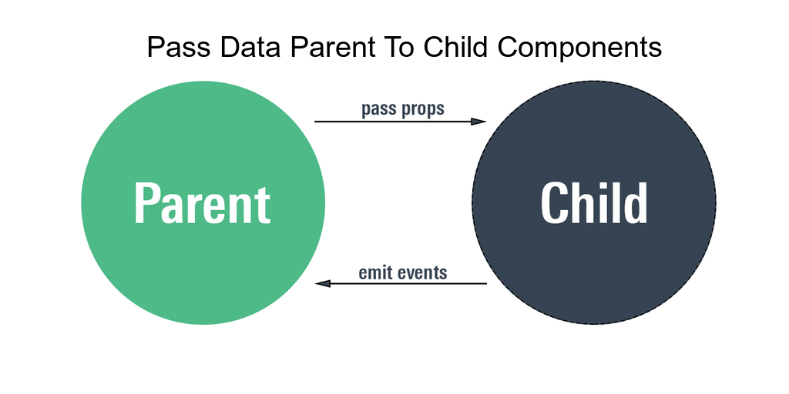

Slide 25
Components tree
App.vue
props: “greeting”
TeslaHeader
TeslaBattery
props
props
props
props
props
TeslaCar
TeslaStats
TeslaCounter
TeslaClimate
TeslaWheels

Slide 26
Pass Props
<tesla-header :greeting= “greetings” />

Slide 27
Emit events
App.vue
props: “greeting”
TeslaHeader
TeslaBattery
emit
props
props
props
props
props
TeslaCar
TeslaStats
TeslaCounter
TeslaClimate
TeslaWheels

Slide 28
Emit events

Slide 29
Tesla Battery Component (Container component)

Slide 30
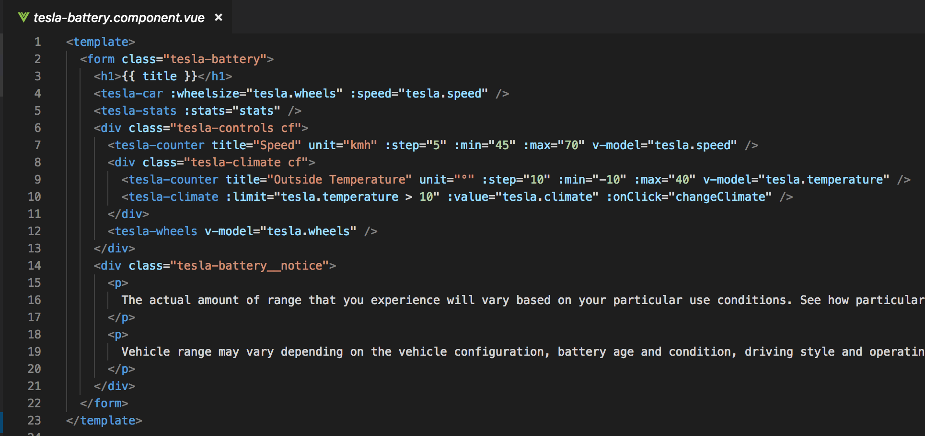
Tesla Battery Component (template)

Slide 31
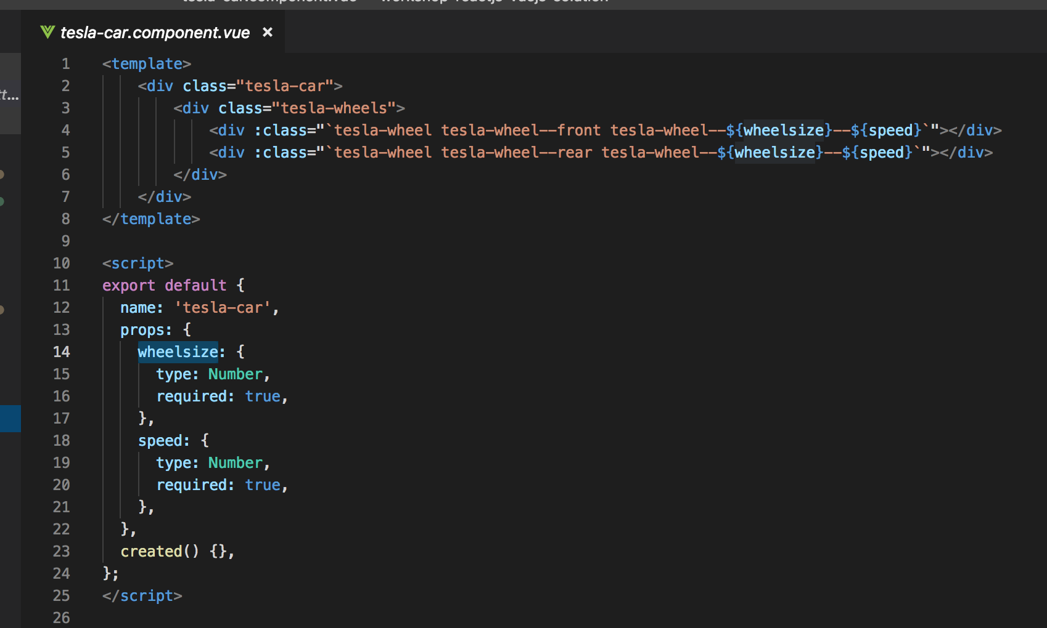
TeslaCar

Slide 32
Data service => TeslaBattery.service
Structure data:
Models –> wheels – climate – speed - temparature
Models = '60', '60D', '75', '75D', '90D', 'P100D'

Slide 33
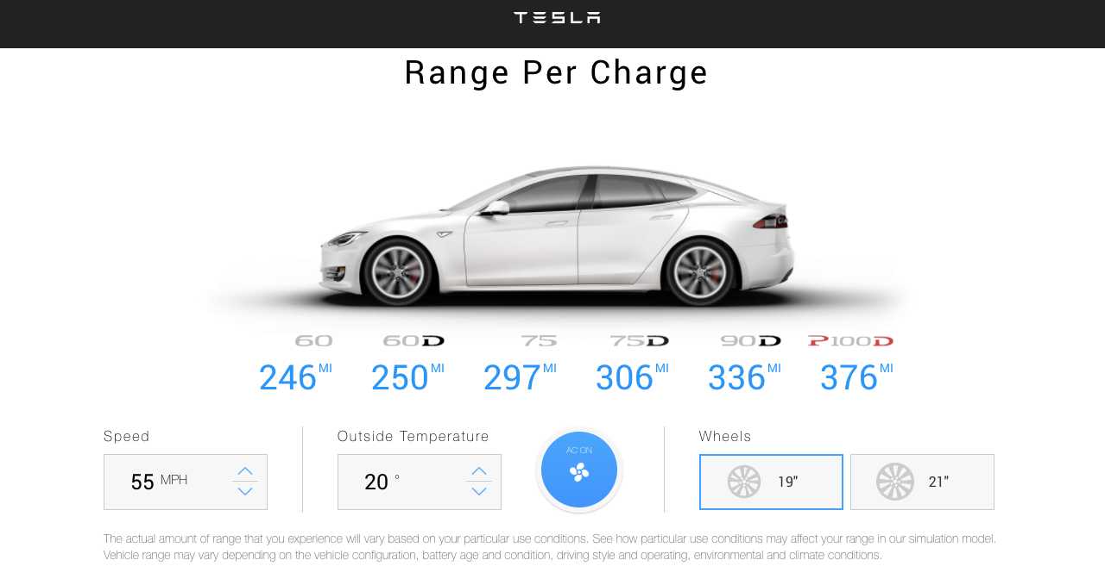
Exercise: check TeslaBattery.service model

Slide 34
Weetjes:
tesla-battery.component → stats()-method (voor het calculceren van de maximale battery range) is called als er een parm veranderd (wheels – climate – speed - temparature)
tesla-battery.component → change parms (wheels – climate – speed - temparature) wordt middle 2-way databinding doorgegeven →zie tesla-battery.component v-model en $emit → value

Slide 35
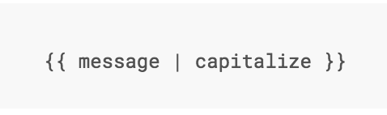
Filter
Notes:
Vue.js allows you to define filters that can be used to apply common text formatting.

Slide 36
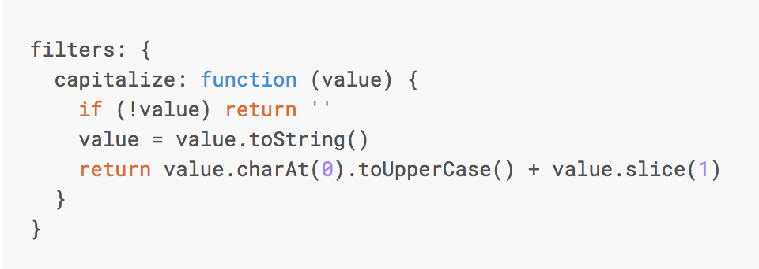
Custom Filter
Notes:
You can define local filters in a component’s options:

Slide 37
TODO
Uitleg component
Uitleg data binding + 2 way databinding
@onBlur @onclick @onfocus. OF :onClick
Name, Props, data(), Methods, Computed() in Child components
Start app with root Vue: new Vue()
Computed properties en watchers

Slide 38
DIRECTIVES
Notes:
Directives are special attributes with the v- prefix. Directive attribute values are expected to be a single JavaScript expression (with the exception of v-for, which will be discussed later). A directive’s job is to reactively apply side effects to the DOM when the value of its expression changes.

Slide 39
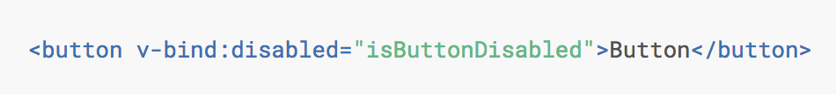
v-bind
Notes:
If isButtonDisabled has the value of null, undefined, or false, the disabled attribute will not even be included in the rendered <button> element.

Slide 40
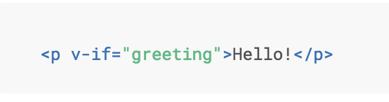
Directive v-if
Notes:
Here, the v-if directive would remove/insert the <p> element based on the truthiness of the value of the expression greeting.

Slide 41
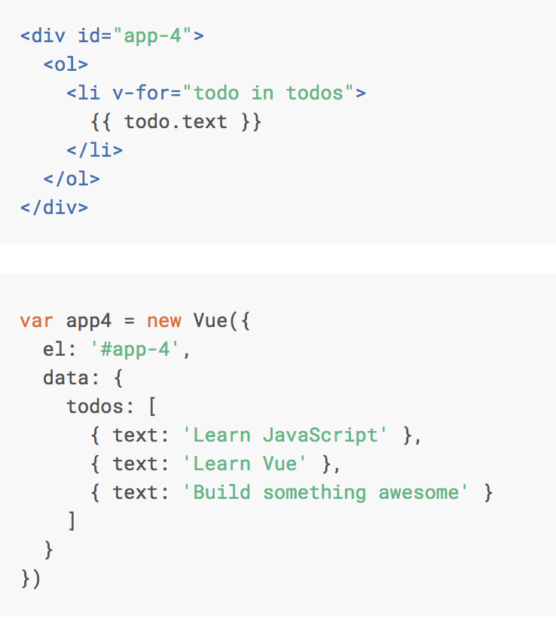
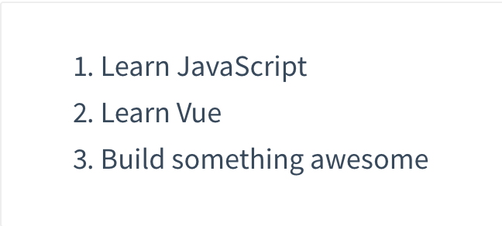
Directive v-for

Slide 42
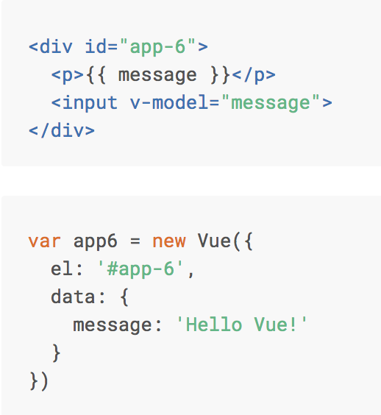
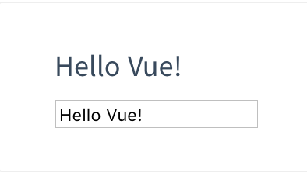
Directive v-model

Slide 43
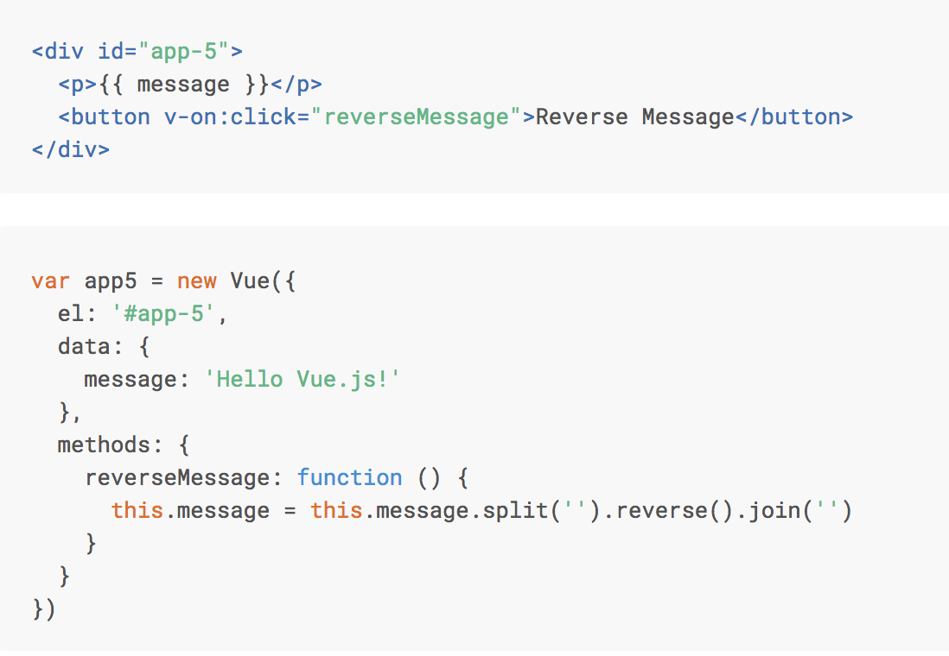
Directive v-on:click

Slide 44
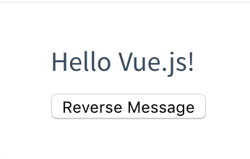
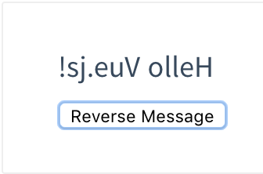
Directive v-on:click

Slide 45
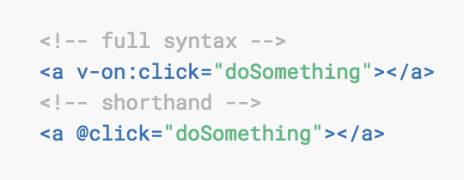
v-on:click Shorthand

Slide 46
@blur.stop.prevent

